Slide 1
Exploring Cognitive Services
[ speaker name]
[ speaker contact methods ]
Notes:
Put your details above.
Each slide contains example script in the notes. Once confident with the content, you can use the headings in the notes as cues to ad-lib the content in your own words.

Slide 2
What are Cognitive Services?
Cognitive services are a set of APIs that are designed to democratize artificial intelligence by enabling systems to see, hear, speak, understand and interpret our needs using natural methods of communication.
What these services generally do is bring structured semantic data to human knowledge I/O with a degree of confidence
“A picture of Satya Nadella happy”
Image of person
Emotional readings
“x% sure that this person is [highest emotion]”
This is about a person

Slide 3
The Cognitive Services
Vision | Speech | Language | Knowledge | Search
Computer Vision Content Moderator Emotion Face Video | Bing Speech Custom Speech Service Speaker Recognition | Bing Spell Check Language Understanding Linguistic Analysis Text Analytics Translator WebLM | Academic Entity Linking Knowledge Exploration QnA Maker Recommendations | Bing Autosuggest Bing Image Search Bing News Search Bing Video Search Bing Web Search

Slide 4
Research Solution
Request a picture of a thing or person (with a specific emotion) by voice
Determine intent for thing or person
Get image to display
Find emotions of person in picture
Be told the highest emotion and confidence
STT
LUIS
Image Search
Emotion
TTS
“A picture of Satya Nadella happy”
This is x% about a thing/person
Image of person
Emotional readings
“x% sure that this person is [highest emotion]”
Notes:
https://www.microsoft.com/cognitive-services/en-us/applications

Slide 5
Services Demonstrated
Speech – Speech To Text & Text To Speech
Search – Bing Image Search
Language – Linguistic Analysis
Vision – Facial Emotion
Knowledge – QnA (bot) maker
Language – LUIS
“A picture of Satya Nadella happy”
Image of person
Emotional readings
“x% sure that this person is [highest emotion]”
This is about a person

Slide 6
Speech – Speech To Text
Request a picture of a thing or person (with a specific emotion) by voice
Determine intent for thing or person
Get image to display
Find emotions of person in picture
Be told the highest emotion and confidence
STT
LUIS
Image Search
Emotion
TTS
“A picture of Satya Nadella happy”
This is x% about a thing/person
Image of person
Emotional readings
“x% sure that this person is [highest emotion]”
Notes:
https://www.microsoft.com/cognitive-services/en-us/applications

Slide 7
Speech To Text + Text To Speech
STT
TTS
Notes:
https://www.microsoft.com/cognitive-services/en-us/applications

Slide 8
Demo
Speech to text and back again
Notes:
Demo 2.1

Slide 9
Search – Bing Image Search
Request a picture of a thing or person (with a specific emotion) by voice
Determine intent for thing or person
Get image to display
Find emotions of person in picture
Be told the highest emotion and confidence
STT
LUIS
Image Search
Emotion
TTS
“A picture of Satya Nadella happy”
This is x% about a thing/person
Image of person
Emotional readings
“x% sure that this person is [highest emotion]”
Notes:
https://www.microsoft.com/cognitive-services/en-us/applications

Slide 10
Demo
Bing Image Search
Notes:
Demo 2.2

Slide 11
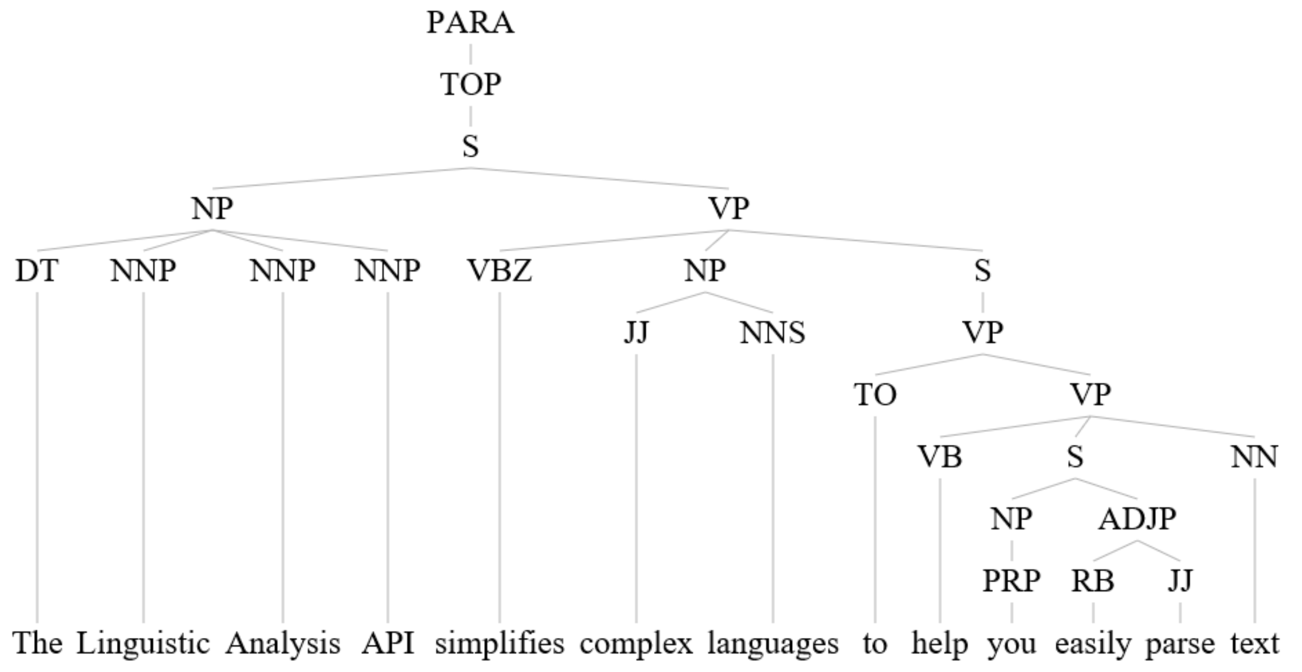
Language – Linguistic Analysis

Slide 12
Demo
Linguistic Analysis
Notes:
Demo 2.3

Slide 13
Vision – Facial Emotion
Request a picture of a thing or person (with a specific emotion) by voice
Determine intent for thing or person
Get image to display
Find emotions of person in picture
Be told the highest emotion and confidence
STT
LUIS
Image Search
Emotion
TTS
“A picture of Satya Nadella happy”
This is x% about a thing/person
Image of person
Emotional readings
“x% sure that this person is [highest emotion]”
Notes:
https://www.microsoft.com/cognitive-services/en-us/applications

Slide 14
Demo
Facial Emotion
Notes:
Demo 2.4

Slide 15

Knowledge – QnA (bot) maker

Slide 16
Demo
QnA Maker
Notes:
Demo 2.5

Slide 17
Language - LUIS
Request a picture of a thing or person (with a specific emotion) by voice
Determine intent for thing or person
Get image to display
Find emotions of person in picture
Be told the highest emotion and confidence
STT
LUIS
Image Search
Emotion
TTS
“A picture of Satya Nadella happy”
This is x% about a thing/person
Image of person
Emotional readings
“x% sure that this person is [highest emotion]”
Notes:
https://www.microsoft.com/cognitive-services/en-us/applications

Slide 18
Demo
LUIS in the researcher app
Notes:
Demo 2.6

Slide 19
Resources
Learn and try at - https://www.microsoft.com/cognitive-services
Docs & getting started - https://docs.microsoft.com/en-us/azure/cognitive-services/
Cognitive Services example code - https://github.com/Microsoft/Cognitive-Samples-IntelligentKiosk
Notes:
As shown

